Slide 1














Giving a Voice to Deaf People in Metal Sector (VOC2DEAF)
STANDARD MACHINE ELEMENTS

Slide 2
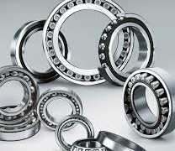
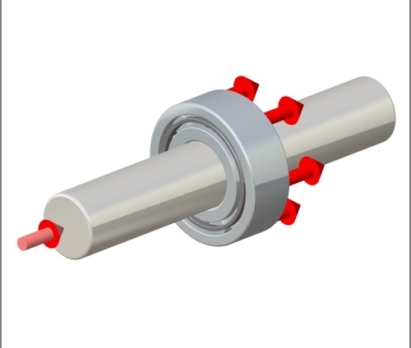
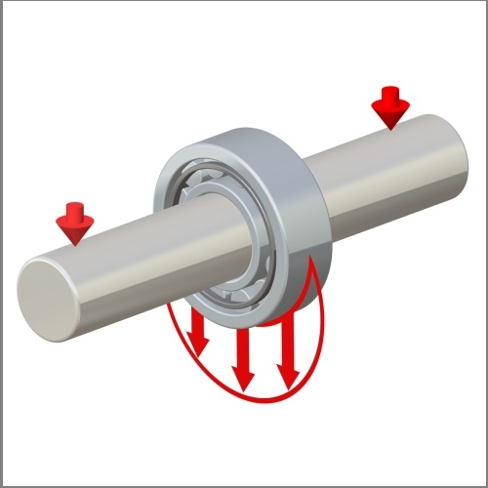
Bearing
A bearing is a machine element. Its function is to facilitate all movements in a machine. Bearings are placed between interconnected machine elements. They provide the transfer of force and rotational motion. They also minimize friction between machine parts.

Slide 3
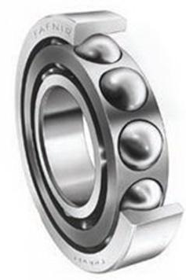
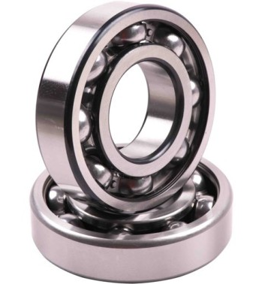
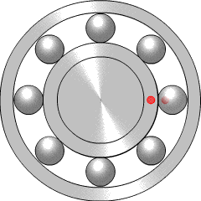
Ball Bearing
Bearing races must be kept separate to work. A ball bearing uses balls to maintain the separation between the bearing races. It supports radial and axial loads and reduces rotational friction. . Ball bearings are used in small load applications.

Slide 4
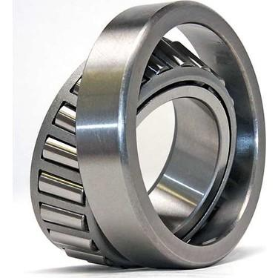
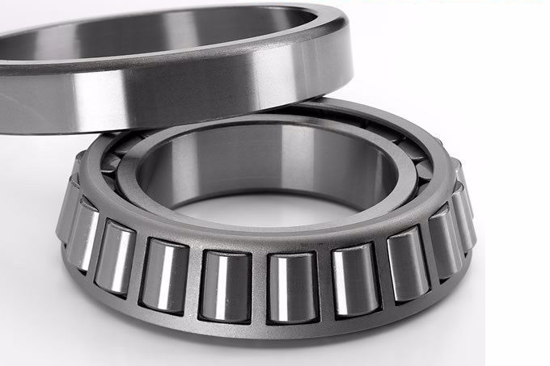
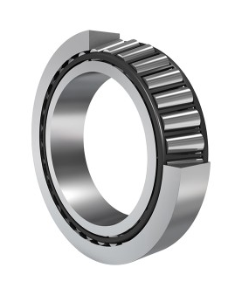
Tapered Roller Bearing
A tapered roller bearing is used to bear combined loads and provide low friction during operation. Tapered roller bearings have a cup and a cone. The cup is the outer ring and the cone assembly consists of an inner ring, rollers, and a cage

Slide 5
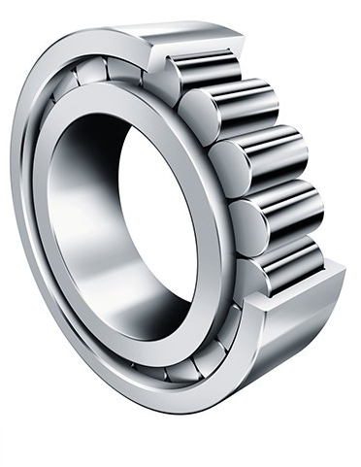
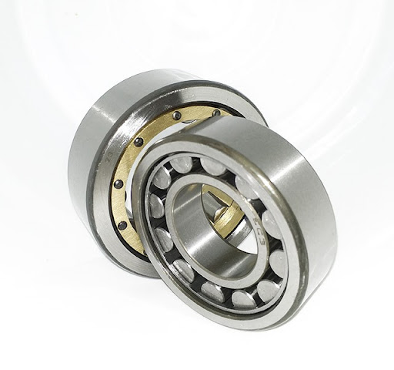
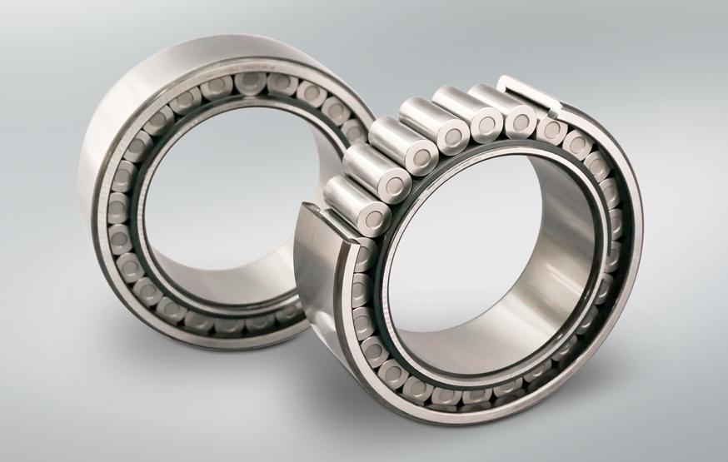
Straight Roller Bearings
Straight roller bearings can be found in applications like conveyor-belt rollers to hold heavy radial loads. These bearings run in cylindrical raceways. They have low-friction, high-radial load capacity, and high-speed capability.

Slide 6
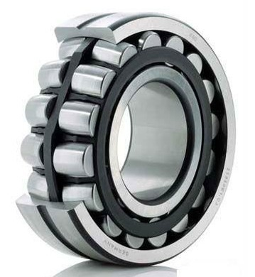
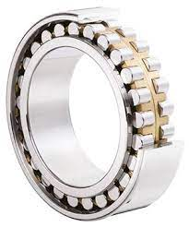
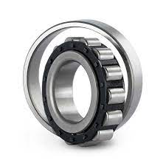
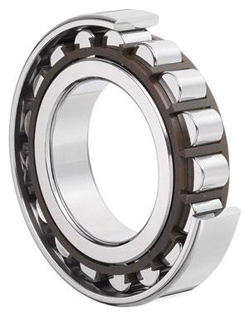
Spherical Roller Bearing
Roller bearings are used in systems under overloads and impacts. They provide high rotational speeds. Roller bearings support rotating shafts and wheels. These bearings transfer loads between rotating shafts and wheels.

Slide 7
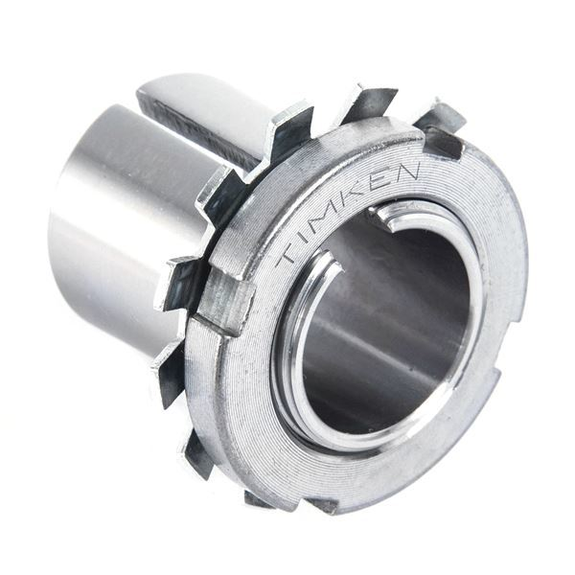
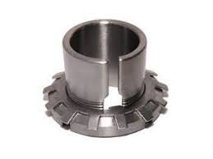
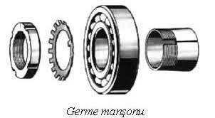
Adapter Sleeves
An adapter sleeve is used to tighten the round nut and the bearing. Adapter sleeves are used for easy assembly and disassembly of tapered bearings.

Slide 8
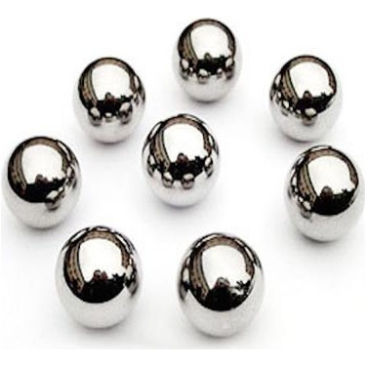
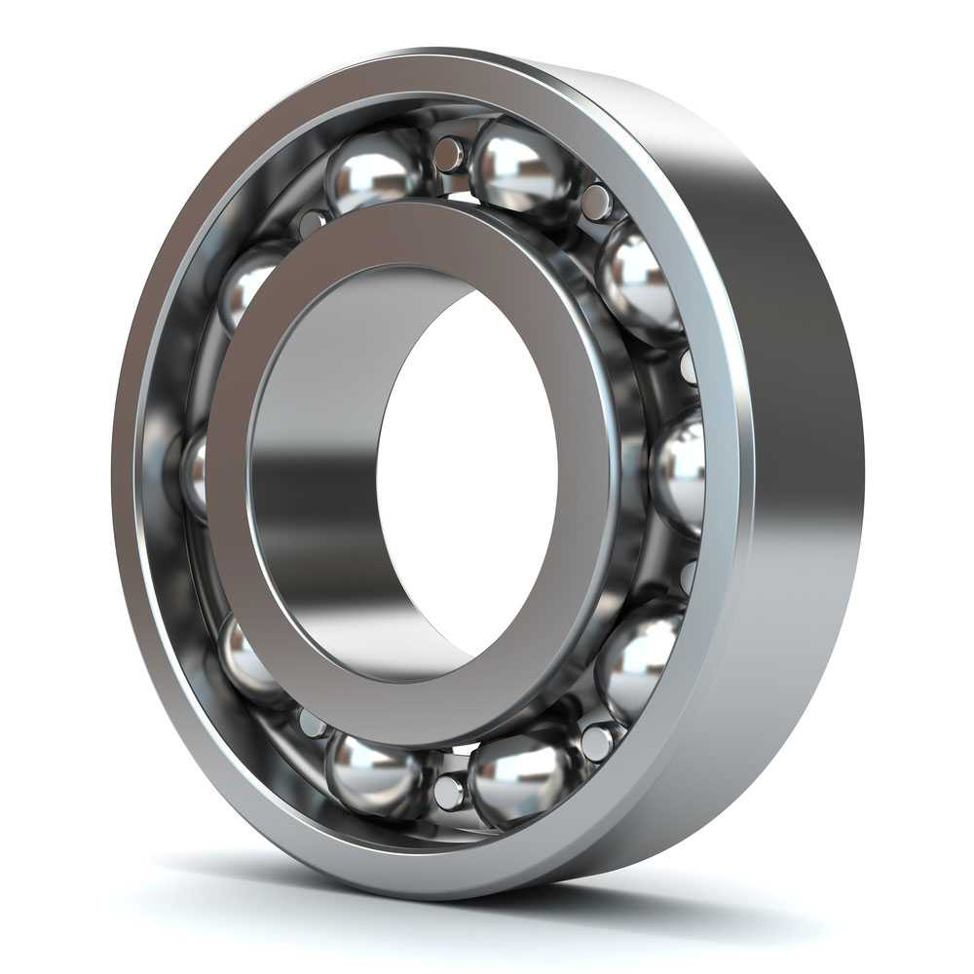
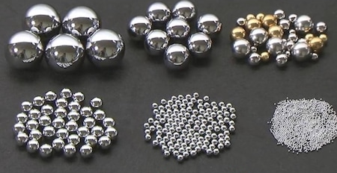
Steel Ball
The ball is a spherical rolling element used in ball- bearings. The friction forces of steel balls are lower than other bearings. Thus, they are used in ball- bearings that must rotate at very high speeds.

Slide 9
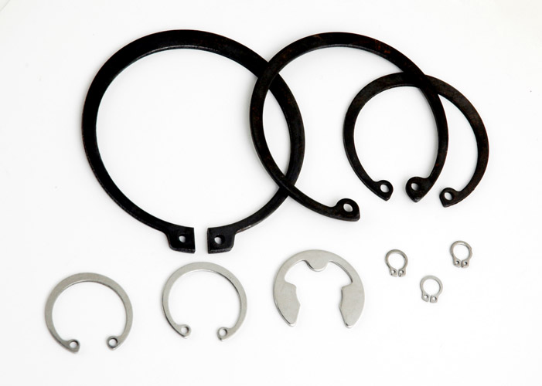
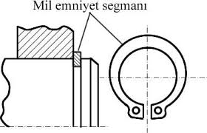
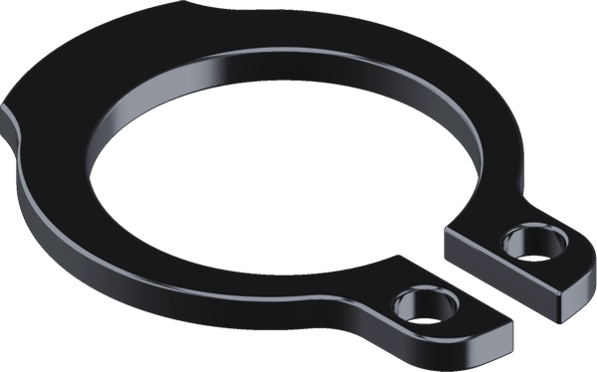
Retaining Ring
The retaining ring is a flexible and round machine element. The retaining ring is placed between the piston and the cylinder. It prevents leakage in a mechanical system. Retaining rings also scrape the lubricants on the cylinders and prevent the burning of the oil.

Slide 10
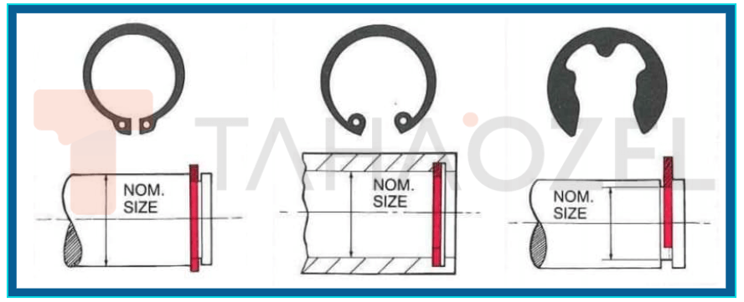
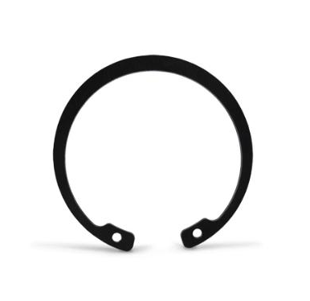
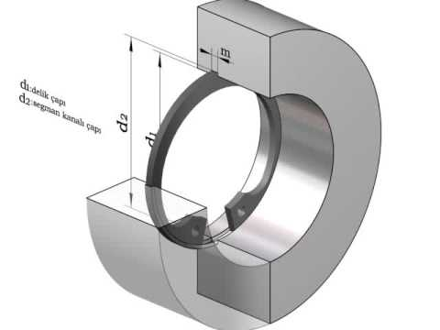
Internal Circlip
An internal circlip is a special type of flexible ring. It is used to secure pinned connections in motors, turbines and pistons. An internal circlip is fitted inside a cylindrical bore.

Slide 11
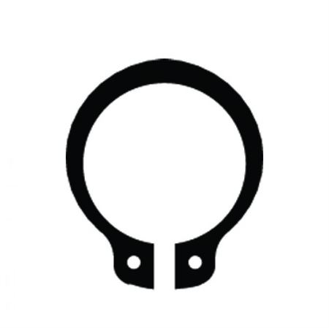
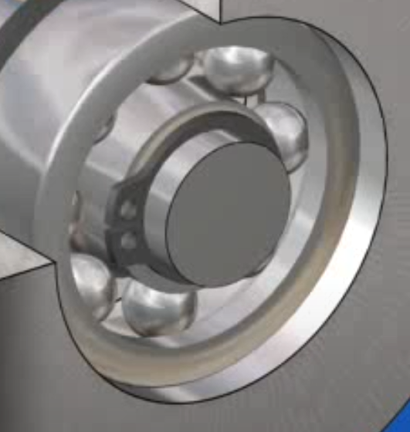
External Circlip
External circlips provide an interference fit onto a machined groove on the shaft. They are used to replace nuts, threaded sleeves, cotter pins, set collars, machined shoulders. They are fitted axially over the outside of a shaft.

Slide 12
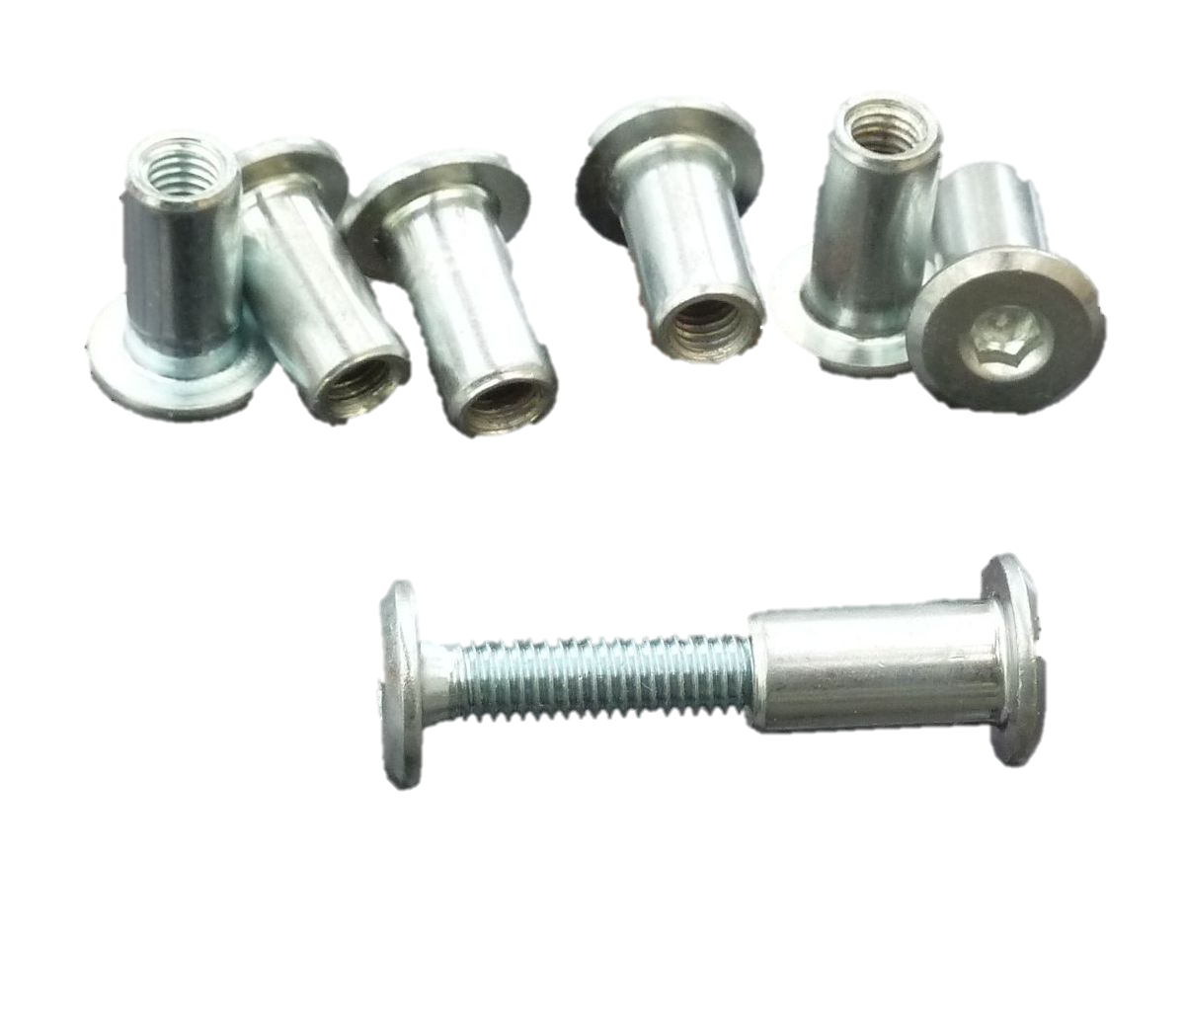
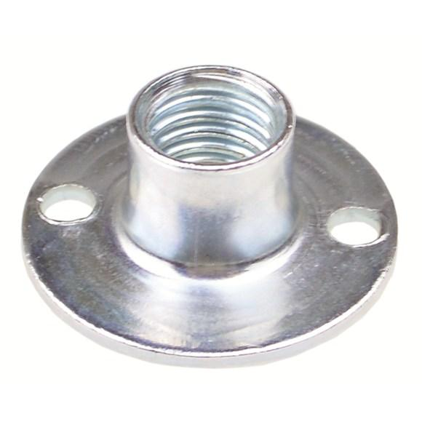
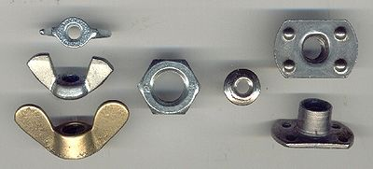
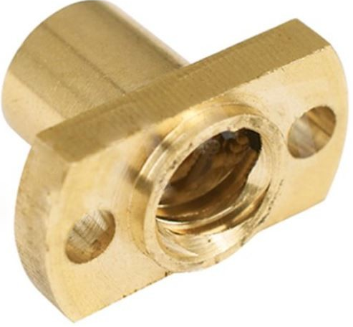
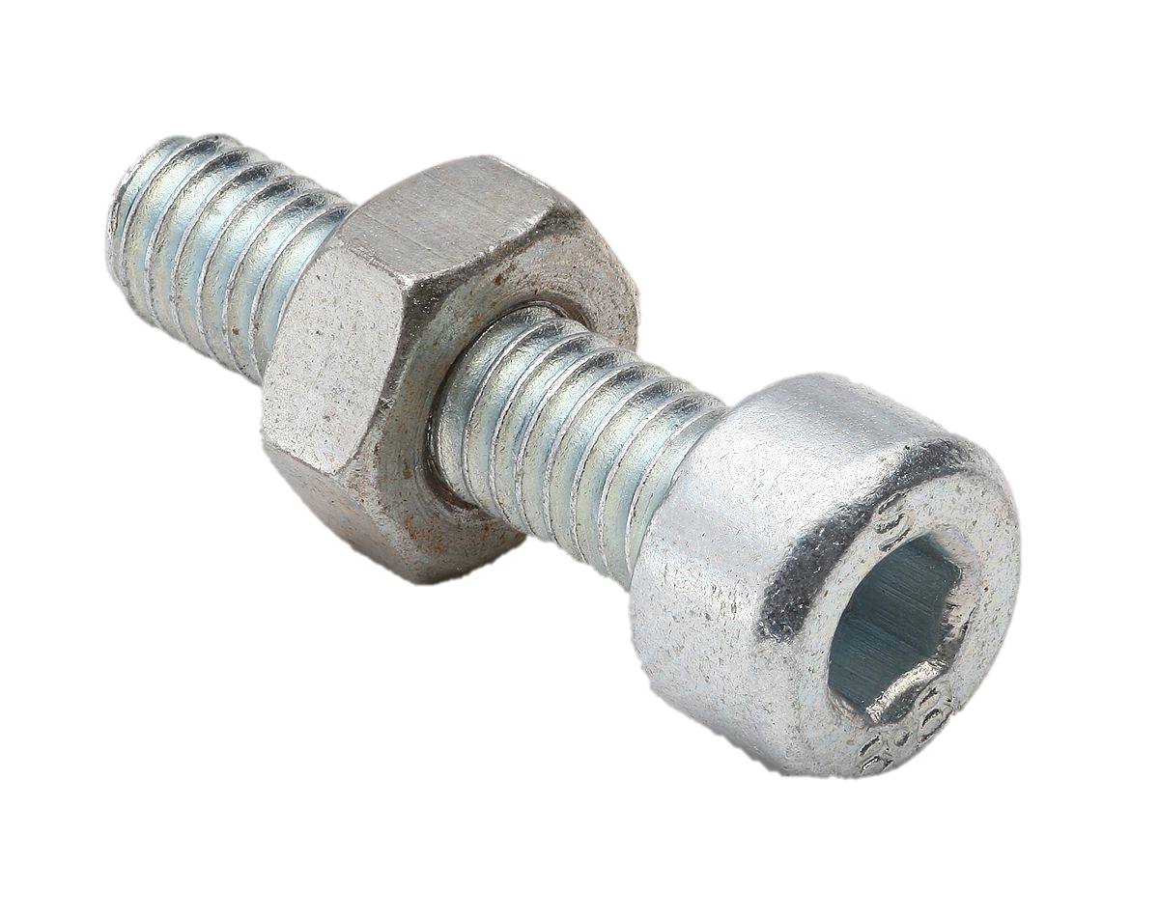
Nut
Nuts are simple machine elements. They connect the machine elements to each other. Bolts and nuts are used together.

Slide 13
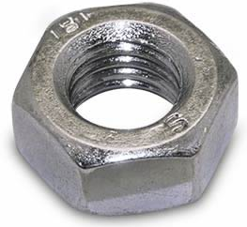
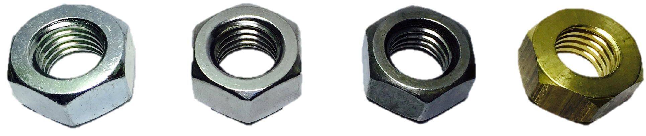
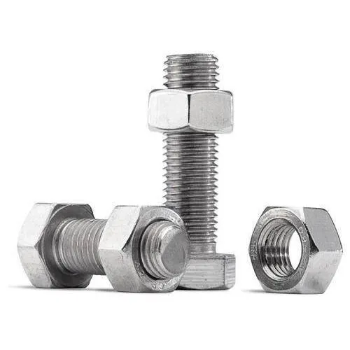
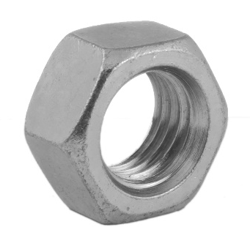
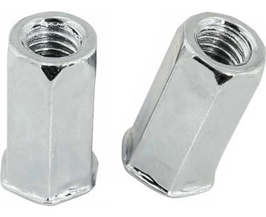
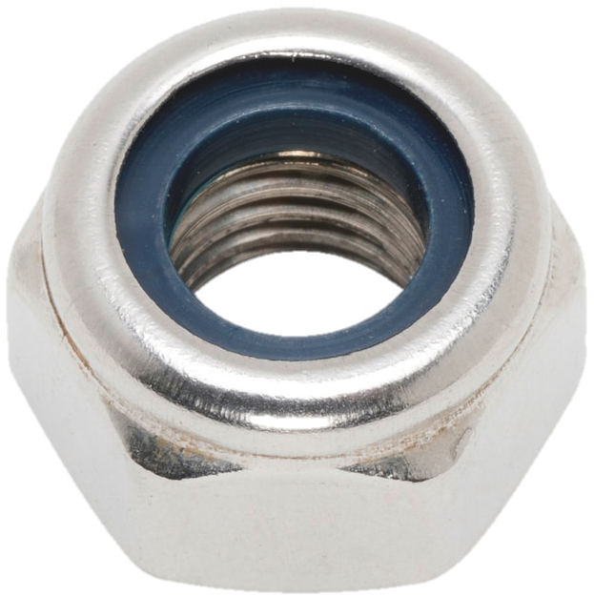
Hex Nuts
Hex nuts are six‑sided nuts. They are the most common nuts used today. Hex nuts are used to connect both metal and wood components to prevent tension and movement. They are used with anchor shackles, bolts, screws, and other externally threaded components.

Slide 14
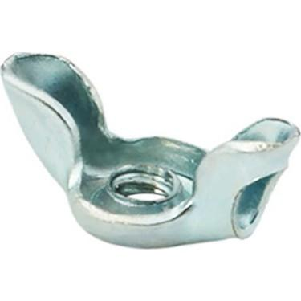
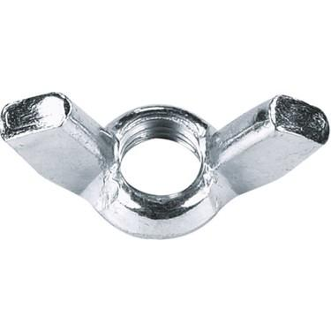
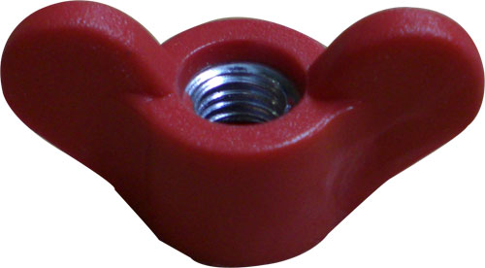
Butterfly Nut
A butterfly nut has wing-like projections. They can hold two or more objects together with a bolt. Butterfly nuts provide leverage in turning with thumb and forefinger.

Slide 15
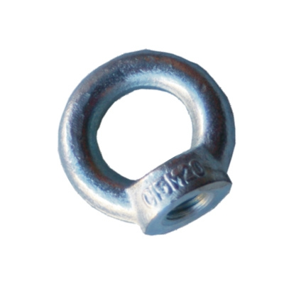
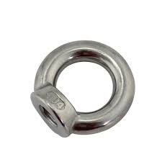
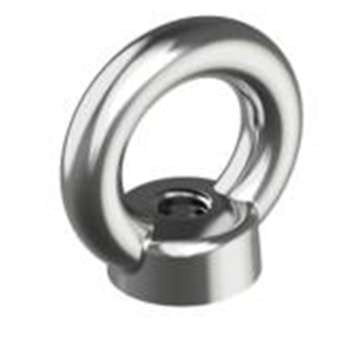
Ring Nut
The ring nut allows ropes, chains, trellises, and hanging baskets to be secured. It nut can be used in both solid and hollow concrete building materials.

Slide 16
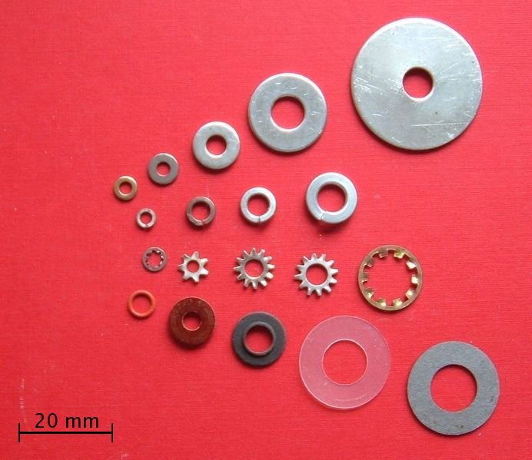
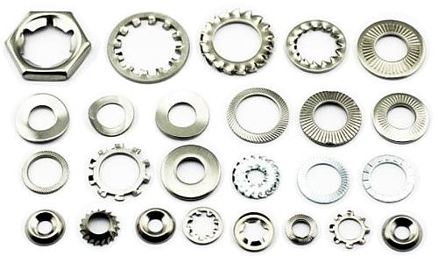
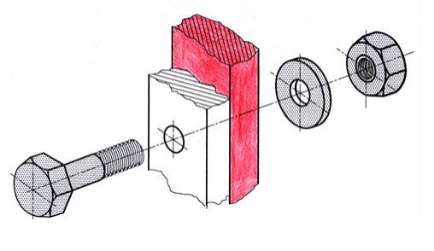
Washer
A washer is a typically disk-shaped, thin, metal or plastic plate with a hole. It is used to distribute the load of a bolt or nut. Washers prevent galvanic corrosion and leakage

Slide 17




Flat Washer
The flat washer is a circular, flat machine element with a central hole for a bolt. They distribute the fastener's load and reduce heat and friction during the tightening process.

Slide 18


Spring Washer
Spring washers are used for locking. They have axial flexibility. Spring washers prevent fastening or loosening due to vibrations.

Slide 19






Bolt
A bolt is a threaded fastener with an external male thread. It is used to fasten two machine elements to keep their position. Bolts pass through an unthreaded hole in a component. A bolt is attached to a washer and nut.

Slide 20



Hexagon-Head Bolt
Hexagon-head bolts are also known as hex bolts. They are named for their six-sided shape. Hex bolts They are used in tight spaces to secure wood, metal, plastic and other materials. They are used in all industries and homes.

Slide 21



Countersunk Screws
Countersunk screws are a type of precision screw. They have a countersunk head. They can sit flush against a target housing. Countersunk screws are used when a smooth surface is required.

Slide 22



Wing Bolt
A wing bolt has a head like a wing nut. Wing bolts create an exceptional fastening. They are designed to be easily operated by hand and they can be adjusted from various positions.

Slide 23



Stud Bolt
A stud bolt is a headless bolt. It looks like a piece of threaded bar and it has teeth on both ends. A stud bolt is used to join multiple parts. Studs are used together with nuts.

Slide 24



Pulley
A pulley is a rotating wheel on an axle or shaft. A pully is used with a belt. Pulleys transfer movement and power from one rotating pulley to another. Different sized pullies can be used to change rotational speed.

Slide 25





Belt
A belt is a flexible machine element. A belt transfers power and rotational motion from one shaft to another. It is used to connect pulleys in parallel.

Slide 26



Gear
A gear is a rotating cylindrical machine element with teeth. It is also called a cogwheel. A gear work with other gears. They can change the speed, torque, and direction of a mechanism.

Slide 27


Spur Gear
Spur gears are a type of cylindrical gear. The teeth of a spur gear are parallel to the shaft axis. In a mechanical setup, spur gears are used to transfer motion and power from one shaft to another. They alter the operating speed, multiply torque, and allow for the fine-tuned control of positioning systems.

Slide 28



Helical Gear
Helical gears are a type of cylindrical gear. The teeth of a helical gear are angled to the shaft. When compared to other gears helical gears are able to carry more load. They can also operate smoother and quieter.

Slide 29



Bevel Gears
Bevel gears are conically shaped gears. These gears are used to transmit power between shafts that intersect at a 90-degree angle. They are used on the axes where the two shafts intersect.

Slide 30




Rack and Pinion
A rack and pinion is a type of linear actuator. For the actuator to work, a circular gear (the pinion) engages with a linear gear; then this translates rotational motion into linear motion.

Slide 31



Worm Gears
A worm gear is a shaft with a spiral thread. Worm gear mechanisms transmit motion and power between two shafts. They change the rotational movement by 90 degrees. A worm gear can increase torque or reduce speed.

Slide 32



Ring and Pinion Gear Sets
Ring and pinion gears are used to spin wheels and axles forwards and backwards. The ring and pinion gears are used in motor vehicles. They improve drive-train performance and provide extra power to the wheels.

Slide 33



Cam and Follower
A cam is a reciprocating, oscillating, or rotating body. The follower imparts reciprocating motion to a cam. Cam and followers convert rotary motion into linear motion.

Slide 34




Springs
Springs are elastic, energy-storing machine elements. They can be metal or plastic. Springs are elongated by tensile force. and they are compressed by pressing force. Springs return to their original shape when the load is removed.

Slide 35



Compression Spring
Compression springs are open-coil helical springs. They are used to release or store energy along the axis. They can maintain or absorb shock between two surfaces.

Slide 36




Extension Spring
Extension springs absorb and store energy. An extension spring bring components that were pulled apart back together again. They are attached at both ends of the components.

Slide 37




Leaf Spring
The leaf spring is an arc-shaped, slender piece of steel. They provide support to any weight added to a vehicle. Leaf springs are stacked with the same material in smaller sizes and bolted together. They are attached to the rear axle and the chassis.

Slide 38



Oil Seal
An oil seal is a machine element that prevents leakage in mechanical systems. It is used to protect shafts and bearings from ingress of dirt and foreign matter and the egress of oil. The oil seal consists of an outer circular metal part and an inner flexible member. Oil seals are bonded to the metal part by chemical adhesive agents.

Slide 39




O-ring
An o-ring is like a torus with a round cross-section. It is also known as a gasket. It is a sealing element in mechanical systems. The o-ring is seated in a groove and compressed between two parts.

Slide 40



Gasket
A gasket is a mechanical seal. Gaskets are made from a flat material such as paper, rubber, silicone, metal. They prevent leakage from or into joined objects.

Slide 41




Differential
The differential is a gear system that provides the right amount of power to wheels. Thus, the vehicle turns corners in a balanced way.

Slide 42



Axle shaft
An axle shaft rotates the wheels and supports the weight of a vehicle. The axles serve to transmit driving torque to the wheel. they also maintain the position of the wheels relative to each other and to the vehicle body. Axle shafts are an integral component of practical wheeled vehicles.

Slide 43





Piston
A piston is a disc-shaped part. It is used in engines, pumps and compressors. It. It converts chemical energy into mechanical energy in motor vehicles. The piston is placed in a cylinder.

Slide 44




Piston Rod
A piston rod connects the piston to the crankshaft. It makes the crankshaft rotate; because it transmits the movement from the piston to the crankshaft.

Slide 45





Shaft
Shafts are cylindrical shaped machine elements. They carry rotating gears, wheels and pulleys. Shafts are used to transfer power between parts.

Slide 46




Crankshaft
Pistons produce energy; a crankshaft transfers this energy to the engine shaft. It supports the engine shaft to rotate. A crankshaft is also called a crank arm.

Slide 47





Camshaft
The camshaft has egg like bulges. It ensures the balanced operation of the engine in vehicles

Slide 48


Bushing
A bushing is an independent plain bearing. It is inserted into a hole. Bushings provide a bearing for rotating machine elements. They eliminate the clearance between mechanical parts.

Slide 49



Shaft Collar
Shaft collars are ring-shaped plastic or metal devices. They hold motor components, gear assemblies, sprockets, and bearings in place. They clamp around a shaft.

Slide 50



Shaft Spacer
A shaft spacer is like a shaft collar. It controls the relative position between two machine elements. A shaft spacer ​is slid over the shaft against the machine element that is to be positioned.

Slide 51


Milling Arbor
A milling arbor is a tool holder for a milling machine. Milling arbors hold rotating milling cutters rigidly. They are mounted on the spindle. They transmit the rotary motion and torque of the spindle to the cutting tool.

Slide 52



Clamping Nut
Clamping nuts are used for fixing rotating parts and reversible shafts. The compact construction ensures a safe function. They allow quick installation using a face wrench.

Slide 53



Pull Stud
Pull studs are the link between the machine drawbar and the tool holder. They are used in the milling process.

Slide 54



Brake Disc
A brake disc is a type of brake. The brake disc is in the brake system of vehicles and provides controlled deceleration. Hydraulically actuated disc brakes are the most used form of brake for motor vehicles.

Slide 55



Flange
A flange is used in connecting pipes, valves, pumps and other equipment to form a piping system. They provide easy access for cleaning, inspection or modification. They are usually welded or screwed. Flanged joints are made by bolting together two flanges with a gasket between them to provide a seal.

Slide 56





Coupling
The coupling connects two shafts together at their ends. A coupling receives power from the motor. It transmits the rotary motion to the shaft.

Slide 57




Center
Centers support the workpiece between the headstock and the tailstock. They prevent flexing of long workpieces.

Slide 58



Collet
Collets are used for clamping cylindrical cutting tools. They are used to hold tools such as drills, milling cutters and taps. Collets are used with a collet holder.

Slide 59



Tap
Taps are tools used to create screw threads. The tapping process creates threads on the inside of a drilled hole. They are numbered 1, 2 and 3, and are used in that order.

Slide 60



Threading Die
Threading dies are tools used for cutting threads. They are used to form or cut an external thread on the outside of rods.

Slide 61


Wedges
Most machines have gears and pulleys. Wedges enable the detachable assembly of these elements on the shafts in a way. They also provide the transmission of movement on the shaft.

Slide 62



Axial Joint
An axial joint is used to provide the connection of the steering gear with the wheel axle components. It receives the movement from the steering wheel and transmits the movement to the rod end. Thus, the wheels turn.

Slide 63




Universal Joint
A universal joint is a universal connector. It transmits rotation through slightly misaligned shafts. It connects an engine or transmission to the drive wheels used in some rear-wheel-drive cars. They are used in light and heavy-duty trucks, agricultural equipment, and construction vehicles.

Slide 64



Ball Joints
Ball joints are spherical bearings. They control the right-left turn of the car.

Slide 65



Oil Pan
An oil pan is an oil tank It houses the crankshaft in a reciprocating internal combustion engine. It also stores the oil in the system and allows it to cool. It is located at the bottom of the engine or gearbox in machines and engines.

Slide 66





Lubricating Nipples
Good lubrication is necessary for a machine to run efficiently. Lubricating nipples are used to lubricate machine elements such as bearings and bushings.

Slide 67



The Oil Tap
The oil tap prevents oil leakage from the crankcase. It is also used to drain the oil in the crankcase.

Slide 68




Gauges
Gauges are precision measuring instruments. They are used to quickly control the dimensions of the machined workpiece.

Slide 69



Plain Plug Gauges
Plug gauges are commonly used in the inspection of or gauging of hole sizes. They determine if the hole is within the upper/lower limits of the tolerance of the components. Each gauge has both go and no-go gauges on each side.

Slide 70


Snap Gauge
A snap gauge is a form of go/no go gauge. It is a limit gauge with permanently or temporarily fixed measurement aperture(s) and gaps. It can quickly verify the outside dimensions of a part.

Slide 71


Telescoping Gauges
Telescoping gauges are indirect measuring devices. This is a T-shaped tool. It consists of a handle, two telescopic rods and a locking screw. It is used to measure the internal diameter of a bore, hole, groove, slot.

Slide 72

Thread Plug Gages
Thread plug gages have two ends: a go- no go. They are used to check tolerances of threaded parts according to a certain specification. They have highly specific calibration tools. They are used to assure quality control and conformity to standards

Slide 73




Pivot Pin
A pivot is used to support rotating machine elements. A pivot pin is a cylindrical, short shaft. It is used to connect movable machine elements.

Slide 74






Cotter
A cotter is a wedge-shaped or tapered piece. It is used to fasten parts of a structure. It secures fasteners nuts and pins. It also prevents the self-dissolving of fasteners.

Slide 75


Roll Pin
A roll pin is a cylindrical or conical, thin, long, machine element. Roll pins are used to fasten shafts. They are also used to centre parts.

Slide 76



Screw Pins
Screw Pins are headless bolts. They have a screw thread throughout their body.

Slide 77



Spring Dowel Pin
Spring dowel pins are slotted pins. They are made from high carbon spring steel material. They are mechanical fasteners. They secure the position of two or more parts of a machine relative to each other.

Slide 78



Taper Pin
A taper pin is a fastener used in a mechanical system. These two ended steel rods have one larger end.

Slide 79



Rivet
A rivet is a permanent mechanical fastener. It consists of a smooth cylindrical shaft with a head on one end.

Slide 80




Hook
A hook is piece of curved or bent back metal, that helps to catch hold of or hang things. It is a machine element used to pull or hang something.

Slide 81



Chain Hoist
A chain hoist is used to lift loads. It has a special gear mechanism. It can lift lower heavy loads with a little force and keep the load in the desired position or can lift the load up to the desired distance.

Slide 82



Swivel
A swivel is a machine element. It is a double ring used to prevent one ring from turning when the other rotates. It allows connected object, such as a chain or rope, swivel caster, or an anchor rode to rotate horizontally or vertically.

Slide 83


Puller
A puller is a standard hand tool used to remove parts such as bearings, pulleys or gears from a shaft. It has two or three legs that circle around the back or inside of a part. It also has a forcing screw which centres up against the end of a shaft.

Slide 84


Circlip Pliers
Circlip pliers are used for removing and installing the retaining rings.

Slide 85



Pliers
Pliers are hand tools used to hold objects firmly. They can be used for bending and cutting wire.

Slide 86


Socket Adapter
A socket adapter is used to remove and install bolts and nuts. It can be used with a ratchet head that come in different sizes.

Slide 87


Universal Joint Socket
Universal joint sockets are used to tighten and loosen bolts or nuts. Since they work with flexible angles they are useful in confined or narrow workspaces.

Slide 88



Allen Socket
Allen sockets are used to tighten bolts and screws with hexagonal heads. They are used in tight work areas that require strong tightening.

Slide 89


Torque Wrench
A torque wrench is used to tighten bolts and nuts with a certain force.

Slide 90



Allen key
An allen key is a hex key. They are a small handheld tool. An allen key is used for turning hexagonal bolt and screw sockets.

Slide 91


Open-End Double-Head Wrench
Open-end double-head wrench is an one-piece wrench with a U-shaped opening.
They grips two opposite faces of the bolt or nut.
They are used to tighten and loosen bolts and nuts.
There are different-sized opening at each end.

Slide 92


Double Head Box Wrenches
Double Head Box Wrench is a hand tool.
They are used for loosening and tightening fasteners such as nuts and bolts.
A box-end wrench fits around a bolt or nut.
Head box allows more versatility and torque.

Slide 93



C spanners
C spanners are hand tools.
They are used loosening retaining rings and adjusting chains.
C spanners incorporate steel roll pins.
They allow the jaws to adjust to fastener.

Slide 94


Spark Plug
A spark plug is a device for delivering electric current.
The spark plug ignites the fuel and air mixture in the combustion chamber by sparking.

Slide 95




Spark Plug Wrench
Spark plug wrench is hand tool.
They remove or tighten spark plugs into the cylinder head.

Slide 96



Adjustable spanner wrench
An adjustable spanner is an open-end wrench with a movable jaw.
Adjustable spanner can be used with different sizes of fastener heads.

Slide 97



Comparator
A comparator is a control instrument. The comparator resembles a clock.
Comparators check the parallelism of the surfaces.
Comparators also check the axes of cylindrical workpieces.

Slide 98





Caliper
Caliper is a measuring instrument having precise divisions on it.
It is used to measure the dimensions of a machined part such as inner and outer diameters, length, and depth.

Slide 99



Micrometer
Micrometer is a precision mechanical measuring instrument.
Micrometer is used to measure the lengths.
Measurements can be made with a precision of one-thousandth of a millimeter (1/1000).

Slide 100



File
A file is a hand tool.
A file is used to remove fine amounts of material from a workpiece.
They are used for smoothing or forming objects, especially of metal.

Slide 101



Vise
Vise is a holding device.
Vise holds the workpiece during hand operations, such as filing, hammering, or sawing.
They have two parallel jaws.
One of the jaws is fixed. The other jaw is movable by a screw, a lever.

Slide 102


Oil can
Oil can holds oil (usually motor oil)
Oil can is used to lubricate machinery.

